Slide 1

Lesson 4.03: Nested For Loops
Microsoft Philanthropies TEALS Program
Introduction to Computer Science
Semester 2

Slide 2
Nested For Loops
After this lesson, you will be able to...
Define and identify nested For Loops, stack trace
Demonstrate for loops using a function and a for loop
Demonstrate nested for loops using two loops nested
Use stack trace to demonstrate the flow of nested for loops

Slide 3
Today’s Plan
Day 1
Do Now
Lesson
Lab
Debrief
Day 2
Do Now
Review
Lab
Debrief
Notes:
Day 1
Duration Description
5 Minutes Do Now
10 Minutes Lesson
35 Minutes Lab
5 Minutes Debrief
Day 2
Duration Description
5 Minutes Do Now
10 Minutes Review
35 Minutes Lab
5 Minutes Debrief

Slide 4
Do Now – Part 1
Enter the following code into your console
def print_6_stars():
my_string = ’ ‘
for i in range(0, 6):
my_string += ' *'
print (my_string)
Write down the output of the function print_6_stars.
Notes:
* * * * * *

Slide 5
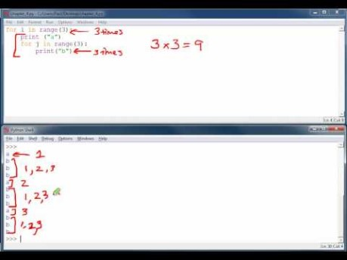
Teacher/Volunteer Only – Explanation Video – For Loops

Slide 6
Do Now – Part 2
Write a function print_star_squares
Call print_6_stars in a loop to output the following >>>python3 print_stars.py
* * * * * *
* * * * * *
* * * * * *
* * * * * *
* * * * * *
* * * * * *
Rewrite the function print_star_squares without using print_6_stars.
Notes:
Can write it as a loop within a loop or a loop calling a function that loops producing the line of stars.

Slide 7
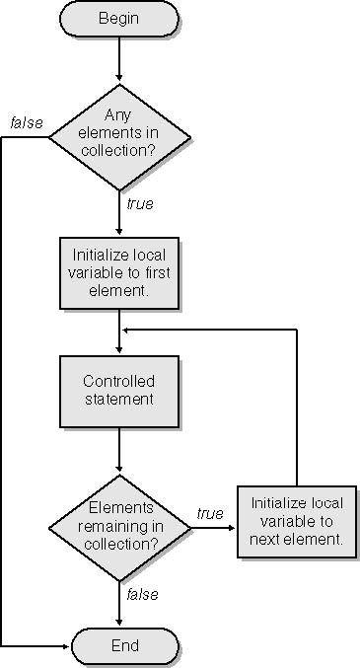
Nested for Loop
Nested for loop
a loop within another loop.
For each iteration of the outer loop the inner loop is iterated
For a nested loop,
place the second loop
after the controlled statement outer loop.
The second loop is called the inner loop.

Slide 8
Alternative Activity
Count From 20 to 99
How do you count from 20 to 99?
Let's chant it together (quickly)
Describe your process.

Slide 9
Alternative Activity - Count From 20 to 99
# Nested Loops
tens = ['twenty', 'thirty', 'forty', 'fifty', 'sixty', 'seventy', 'eighty', 'ninety’]
ones = ['', 'one', 'two', 'three', 'four', 'five', 'six', 'seven', 'eight', 'nine’]
for ten in tens:
for one in ones:
print(ten + ' ' + ones)

Slide 10
Alternative Activity – len() and range ()
# Nested Loops
tens = ['twenty', 'thirty', 'forty', 'fifty', 'sixty', 'seventy', 'eighty', 'ninety’]
ones = ['', 'one', 'two', 'three', 'four', 'five', 'six', 'seven', 'eight', 'nine’]
for i in range(0, len(tens)):
for j in range(0, len(ones)):
print(tens[i] + ' ' + ones[j])

Slide 11
Labs - Drawing images using nested for loops
For each of the following labs, write a function that will draw the desired output.
You may use an extra function if you find it helpful.

Slide 12
Lab 1
Write a function, draw_7(), to draw the 7x7 square
* * * * * * *
* * * * * * *
* * * * * * *
* * * * * * *
* * * * * * *
* * * * * * *
* * * * * * *

Slide 13
Lab 2
Write a function stars_and_stripes(), that will draw a 3 sets of rows.
1st a row of 7 stars followed by a row of 7 dashes
* * * * * * *
- - - - - - -
* * * * * * *
- - - - - - -
* * * * * * *
- - - - - - -

Slide 14
Lab 3
Write a function, increasing_triangle() that will print out following:
1
12
123
1234
12345
123456
1234567

Slide 15
Lab 4
Use a function to Create your own drawing

Slide 16
Exit Ticket/Reflection
Day 1
Inform students that there will be a Unit 4 Quiz after Lesson 4.04.
Go over common questions the students have.
Day 2
Share out your Bonus attempts with the class

